Slide 1


ISTANBUL TECHNICAL UNIVERSITY
Faculty of Aeronautics and Astronautics
Department of Climate Science and Meteorological Engineering

Slide 2
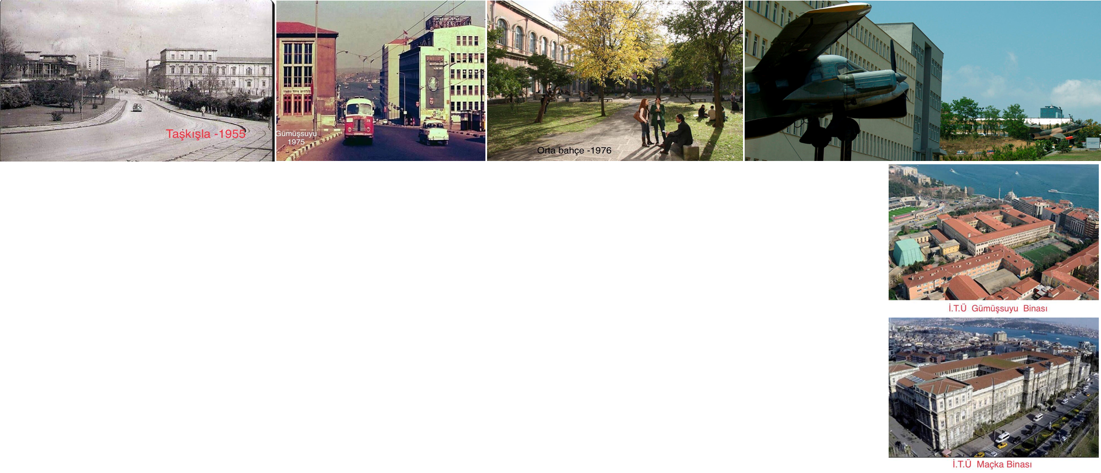
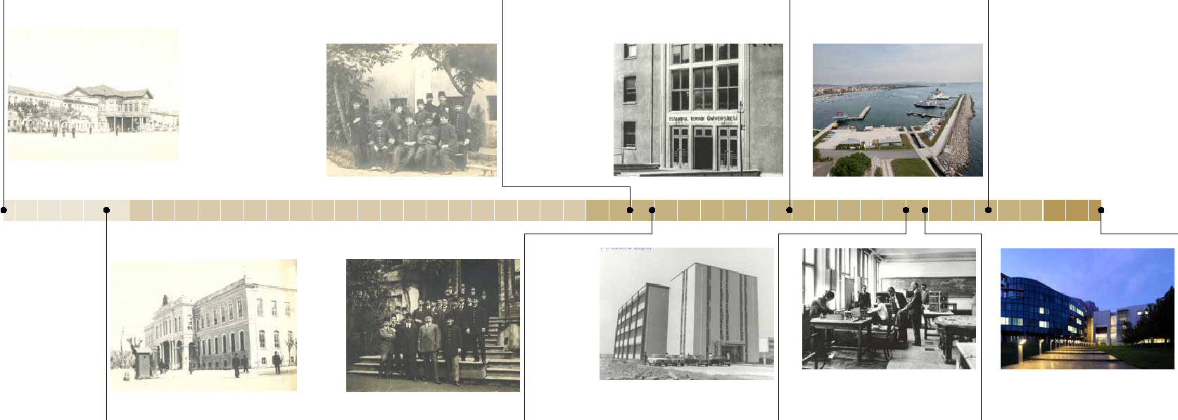
ITU HISTORY
Imperial Naval Engineering School
1773
School of Engineers and Architects
1909
Higher School of Engineering
1944
Maritime Faculty Campus
1988
1795
Imperial School of Engineering
1914
First Engineer Graduates
1970
Ayazağa Main Campus
1974
Transition to two-tier undergraduate and graduate education
2024
251. Yıl

Slide 3
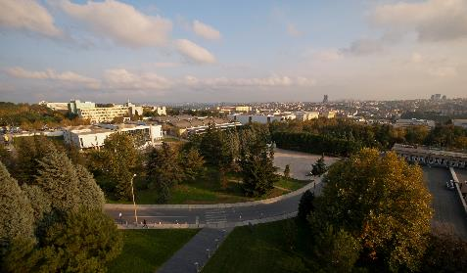
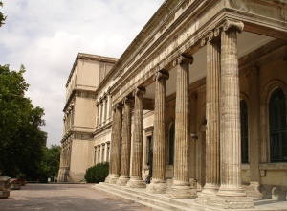
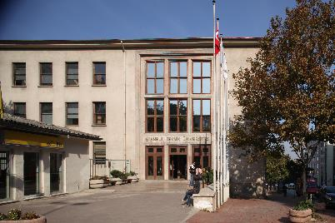
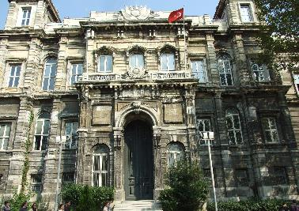
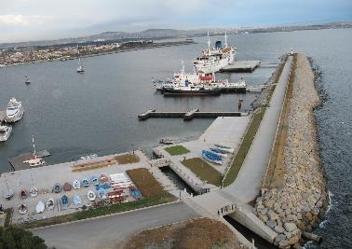
ITU CAMPUSES
Ayazağa Ana Kampüs (8 Fakülte)
    İnşaat Fakültesi
    Elektrik - Elektronik Fakültesi
    Maden Fakültesi
    Kimyasal Metalurji Fakültesi
    Bilgisayar ve Bilişim Fakültesi
    Fen Edebiyat Fakültesi
    Gemi İnşaatı ve Deniz Bilimleri Fakültesi
    Havacılık ve Uzay Bilimleri Fakültesi
Taşkışla Kampüs
    Mimarlık Fakültesi
    Sosyal Bilimler Enstitüsü
Gümüşsuyu Kampüs
    Makine Mühendisliği Fakültesi
    Tekstil Teknolojileri ve Tasarımı Fakültesi
    Enstitüler
    Enerji Enstitüsü
    Fen Bilimleri ve Teknoloji Enstitüsü
    Sosyal Bilimler Enstitüsü
    Bilişim Enstitüsü
    Avrasya Yer Bilimleri Enstitüsü
    Deprem Mühendisliği ve Afet Yönetimi Enstitüsü
Maçka Kampüs
    İşletme Fakültesi
    Yabancı Diller Yüksekokulu
    Konservatuvar
Tuzla Kampüs
    Denizcilik Fakültesi
Notes:
8 faculties

Slide 4

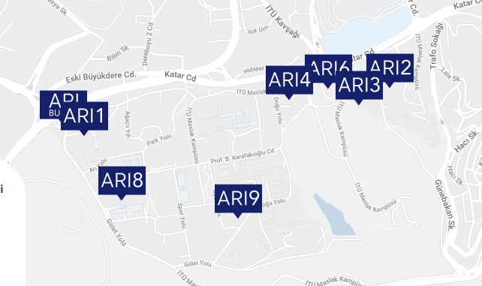
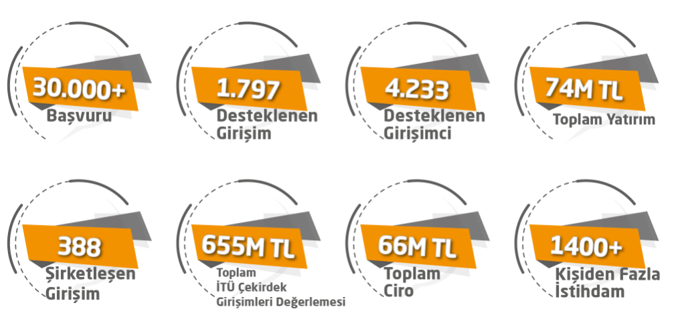
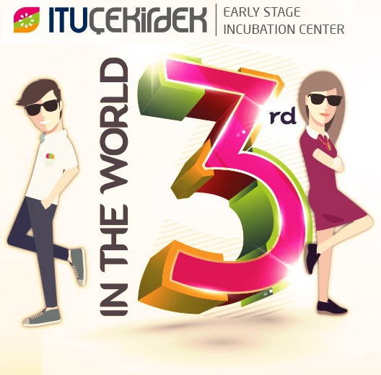
ITU ARI TEKNOKENT & ITU ÇEKİRDEK
ITU ARI Teknokent
- A versatile, efficient, and sustainable university-industry collaboration platform.
- 2,500 successful R&D projects (148 patented).
- 276 R&D companies.
$752 million in revenue.
ITU Çekirdek Early-Stage Incubation Center
All entrepreneurs with technological and innovative business ideas, who believe their ideas are innovative and can be transformed into commercial activities, are welcome.

Slide 5
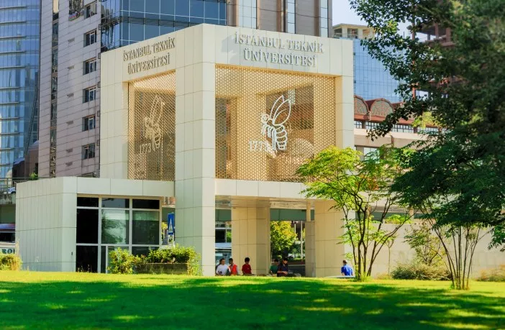

ITU STATISTICS
Academic Members
2,330 Academician
Graduate Program
25.942 students
  13 Dual Degree Program (SUNY)
Master Program
12.345 master students
  118 master programs
  71 doctorate programs
Graduates
More than 140.000 graduates
Foreign Recognition
University | Country | Number of Accredited Programs
İstanbul Teknik Üniversitesi | Türkiye | 26

Slide 6
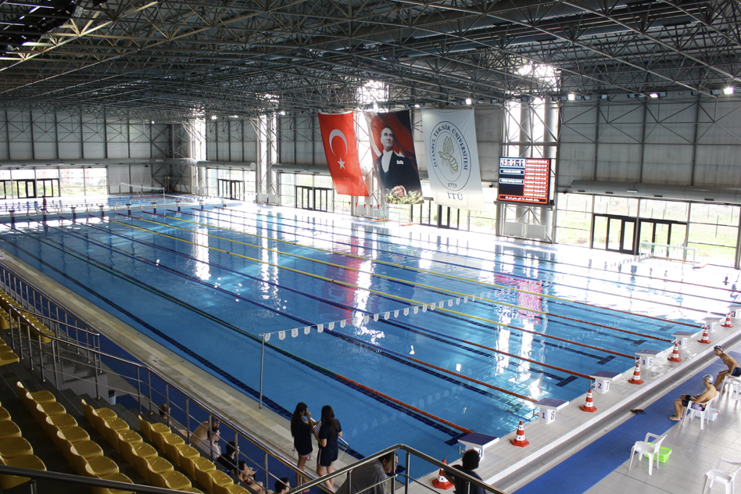
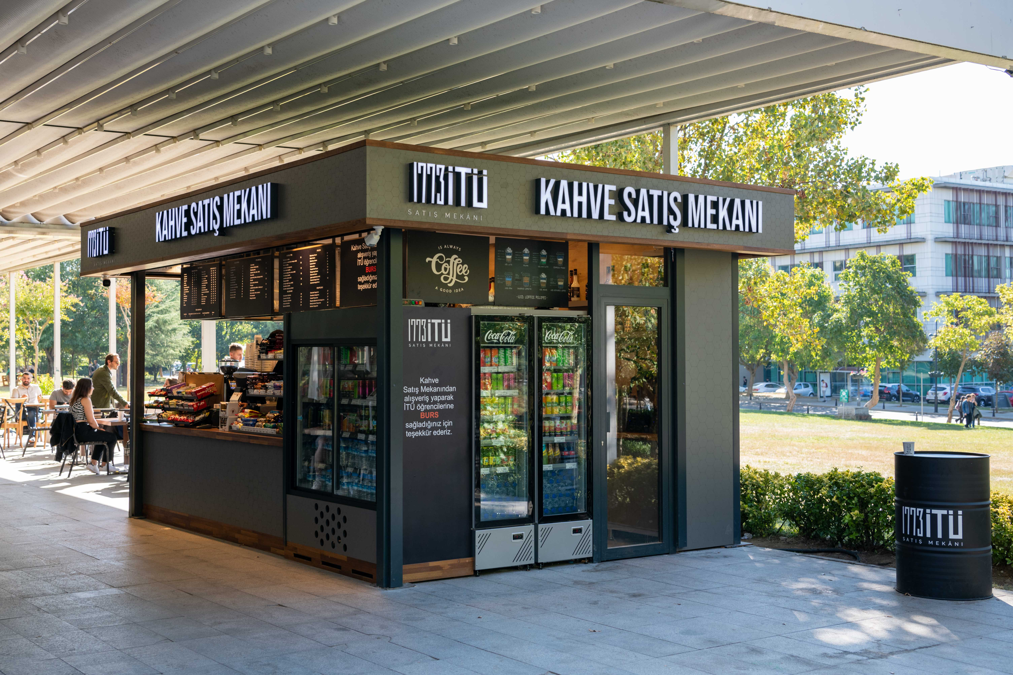
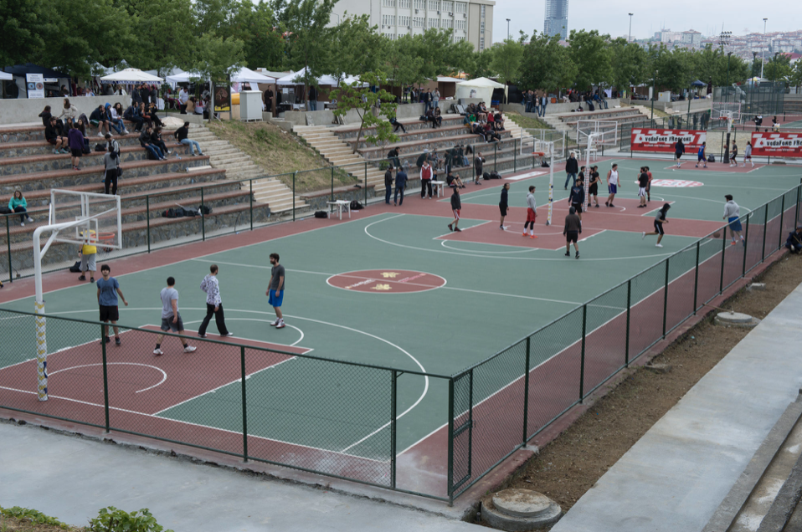
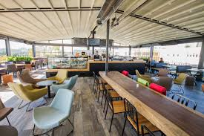
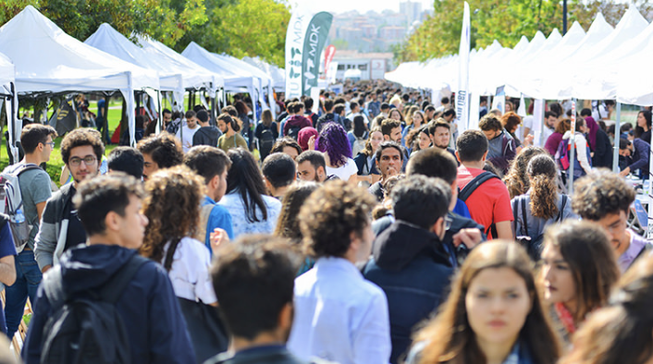
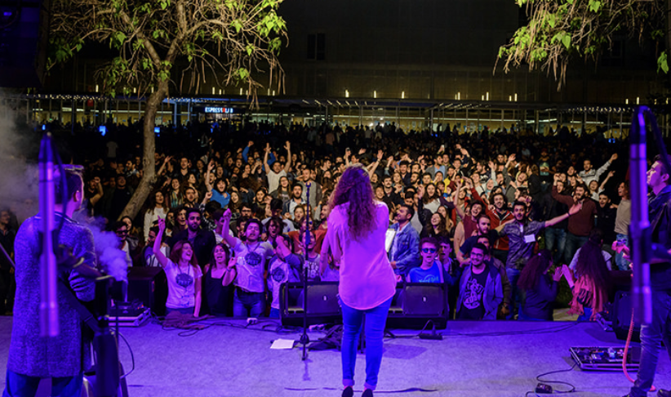
SOCIAL FACILITIES
Sports Facilities
Gated Gyms : Areas suitable for team sports such as basketball, volleyball and handball.
Fitness Centers : Modern ekipmanlarla donatılmış spor salonları.
Open Area Facilities : Football, tennis courts and an outdoor swimming pool.
Food and Beverage Areas
Campus Canteens : A variety of food options at affordable prices for students.
Restaurants and Cafes : Social spaces within the campus.
Culture and Art
Concerts and Events : Concerts and theater performances organized by ITU Conservatory.
Club Activities : More than 200 student clubs, giving you the chance to participate in activities that match your interests.
Social Activities
Festivaller: Spring festivals and sports festivals.
ITU Cinema Club : Weekly film screenings and filmmaking workshops.

Slide 7
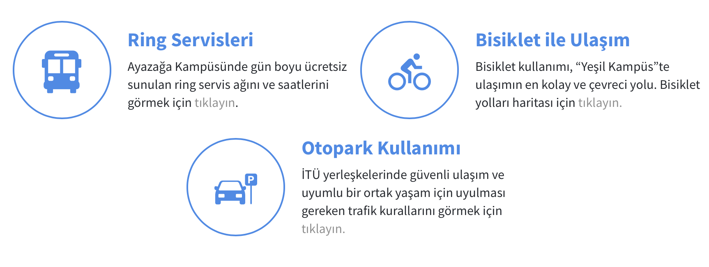
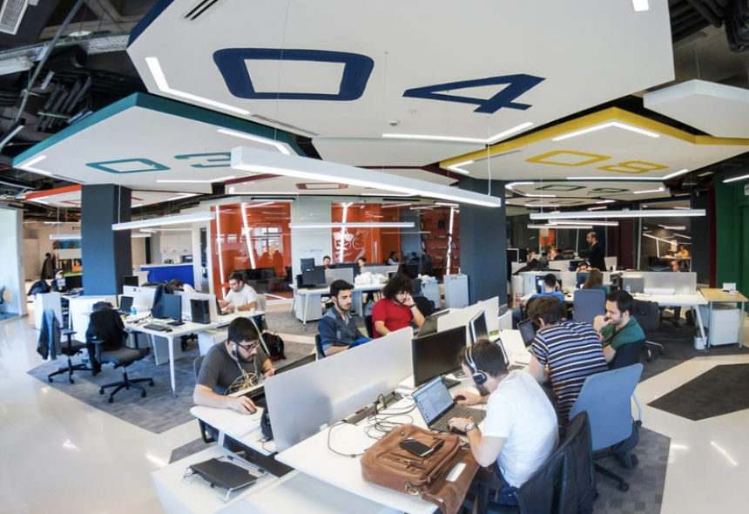
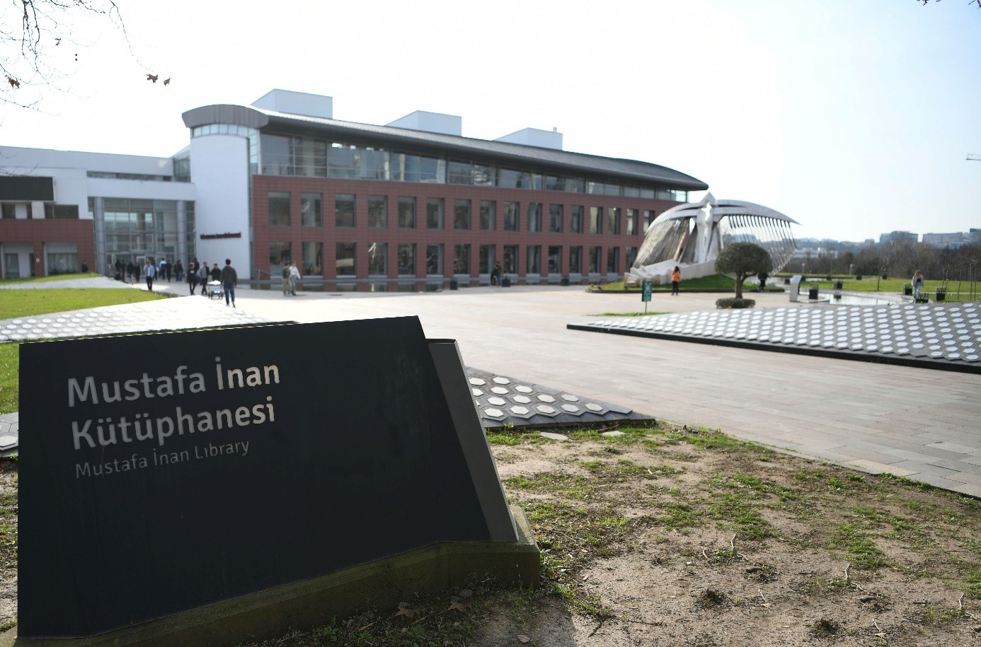
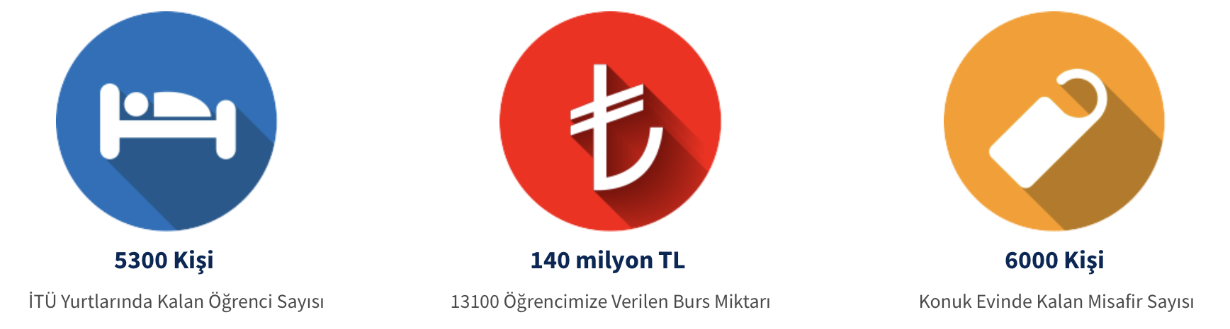
SOCIAL FACILITIES
Technology and Research Areas
Libraries : Rich resources and workspaces.
Laboratories and Workshops : Research centers equipped with the latest technology.
Transportation
On-Campus Transportation : Ring services and walking paths.
Connection to the City: Public transportation options such as metro,
metrobus and buses.

Slide 8
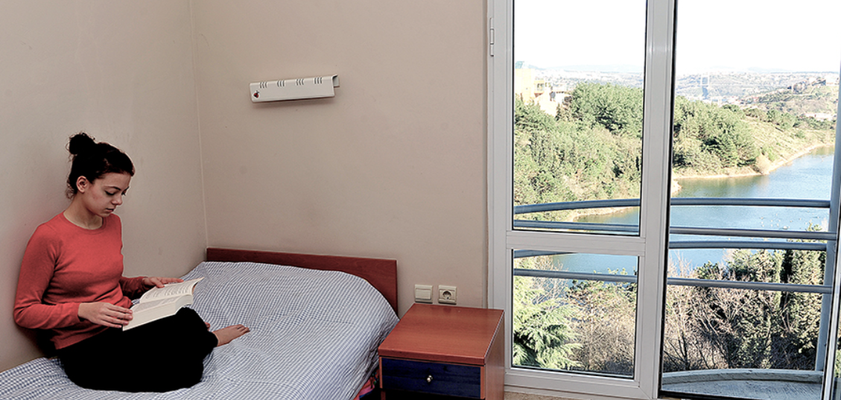
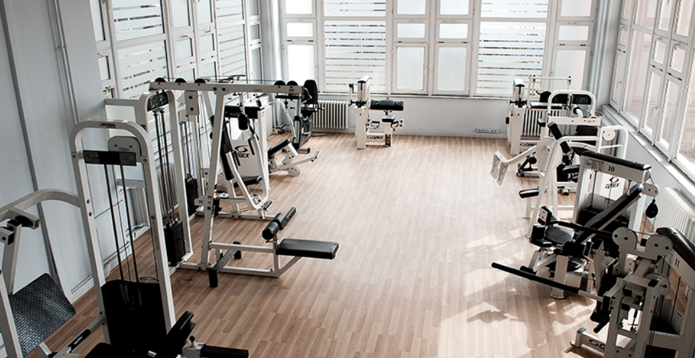
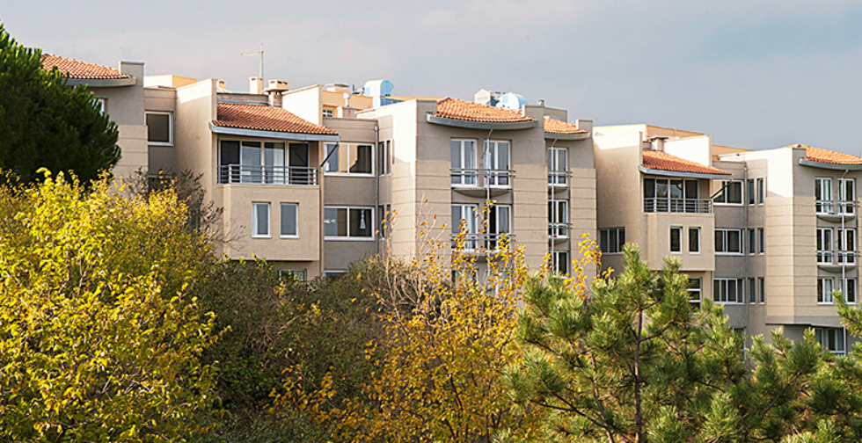

LODGEMENT FACILITIES
Sports Hall
Dining Hall
Rest room
Table tennis court
Study room
Shared kitchen

Slide 9
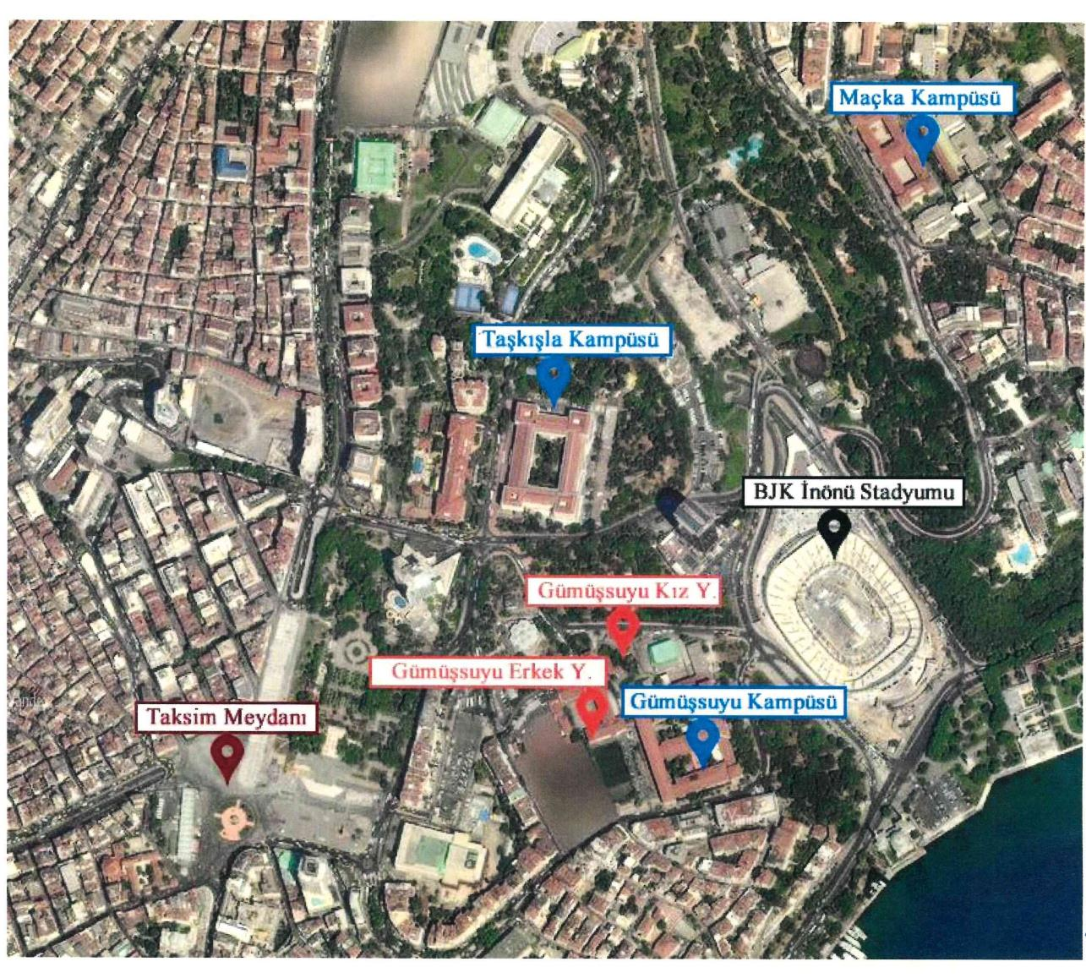
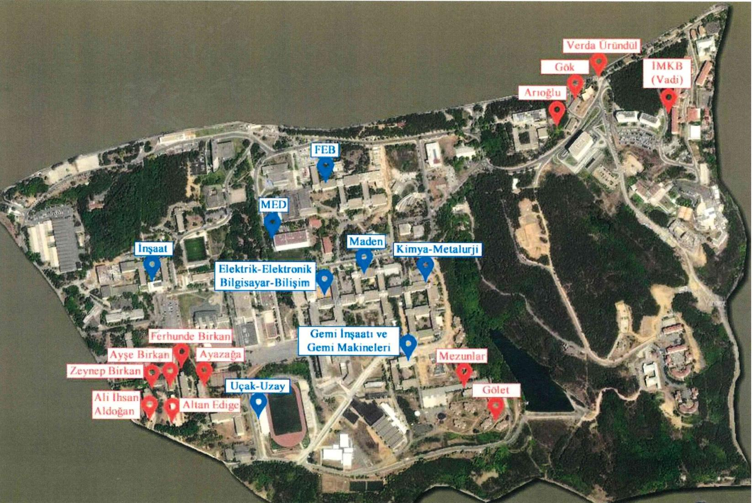
LODGEMENT FACILITIES
Red dots represent Gümüşsuyu Campus dormitories
Red dots represent Ayazağa Campus dormitories

Slide 10
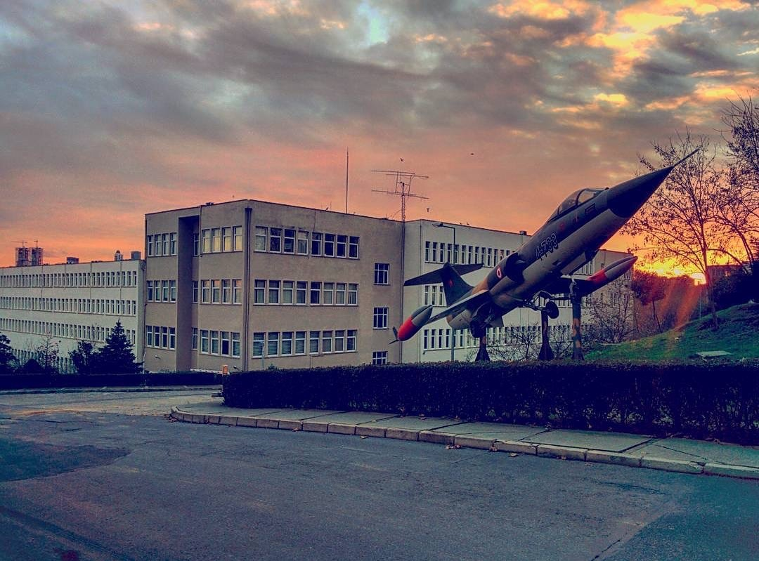
Faculty of Aeronautics and Astronautics(UUBF)
1941
Department of Aeronautical Engineering, It was established as a specialty branch under the Department of Mechanical Engineering.
1944
Department of Aeronautical Engineering became a separate engineering department in the Faculty of Mechanical Engineering
1953
Meteorological Engineering Department established within the Faculty of Electricity
1983
Faculty of Aeronautics and Astronautics was established.
Aircraft Engineering
Meteorological Engineering
Aerospace Engineering (new department)

Slide 11

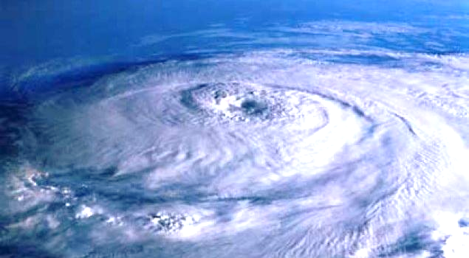

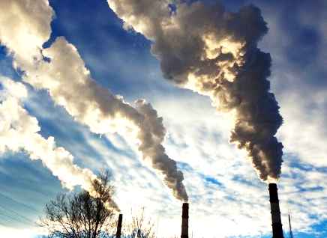
RESEARCH TOPICS
In the Climate Science and Meteorological Engineering program, courses in atmospheric sciences such as:
- Atmospheric Thermodynamics,
- Atmospheric Physics,
- Weather Analysis and Forecasting,
- Climate,
- Air Pollution,
- Solar and Wind Energy,
- Hydrology,
- Agricultural Meteorology, and more
are combined with fundamental engineering courses, including:
- Fluid Mechanics,
- Statics,
- Strength of Materials,
- Fluid Dynamics,
- Design,
to develop predictions and designs concerning what the future may hold and how it might affect us.
4/18

Slide 12
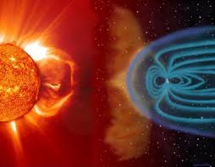
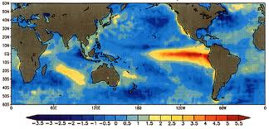
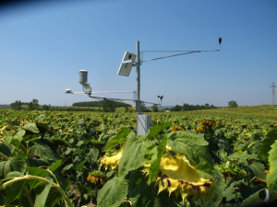
EDUCATIONAL OUTPUTS
Understanding the cause-and-effect relationships of meteorological events by examining the atmosphere as a whole;
Combining theory and technology through design courses to develop the most suitable designs for our living environment;
Gaining technical experience through experimental courses;
Acquiring the ability to develop algorithms for meteorological models through courses in fundamental mathematics, physics, and modern computer programming.
5/18

Slide 13
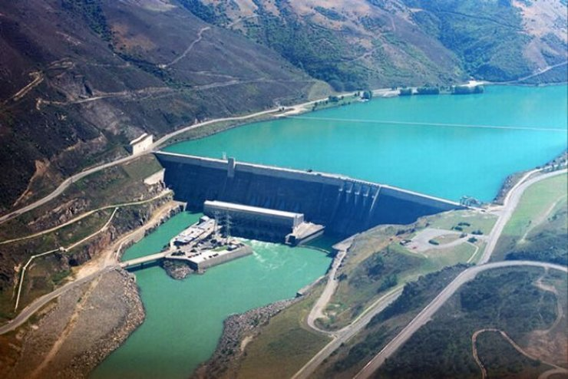
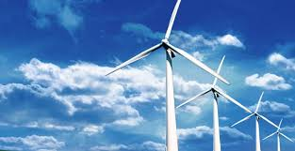
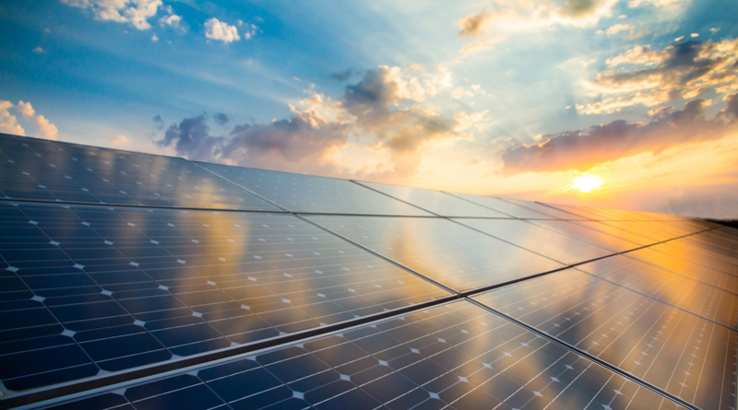
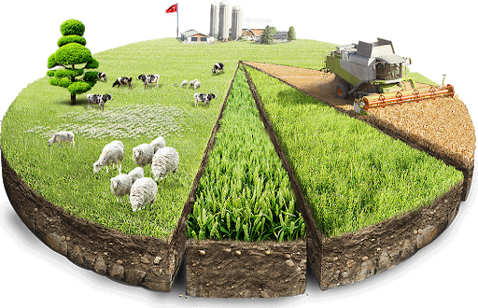
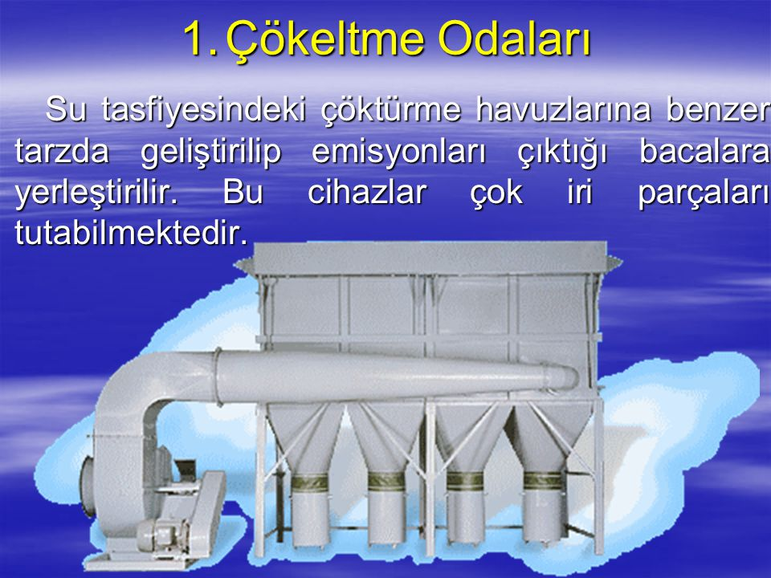
EDUCATIONAL OUTPUTS
Design courses provide students with the opportunity to translate their theoretical engineering education into practice through topics such as:
- Hydrology,
- Renewable Energy,
- Air Pollution Control,
Agricultural and Forest Meteorology
Aviation Meteorology
7/18

Slide 14
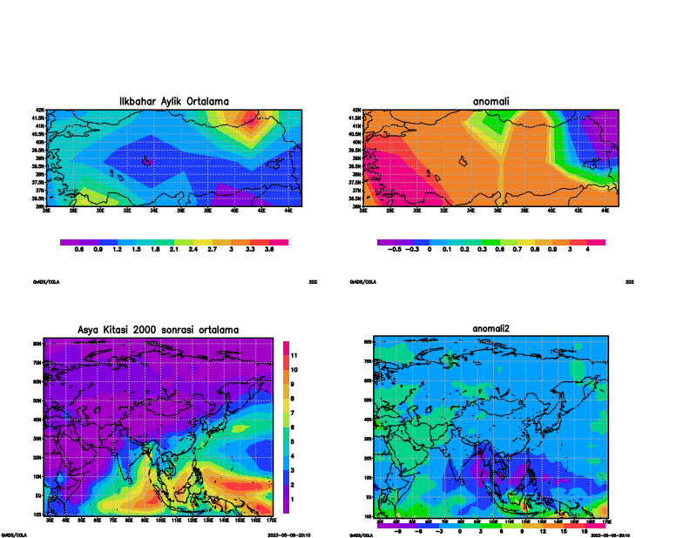
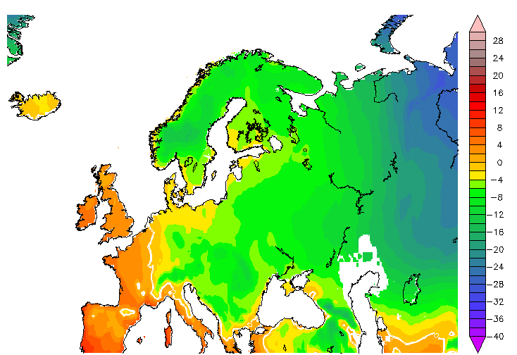
CLIMATE SCIENCE AND METEOROLOGICAL ENGINEERING:
AN INTERDISCIPLINARY ALLIANCE
Data Analysis and Visualization: Statistical analysis is performed with languages ​​such as Python, MATLAB, R. Maps, graphs, time series are created.
Numerical Modeling: Models such as WRF and AERMOD are run. These models are based on software infrastructure and require high processing power.
Artificial Intelligence and Machine Learning: AI algorithms are used to improve the accuracy of forecasts, classify extreme weather events, or create climate projections.

Slide 15
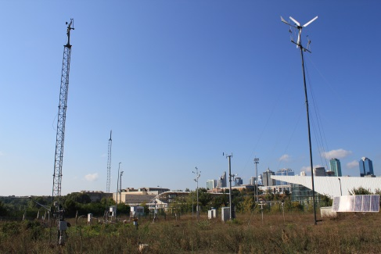
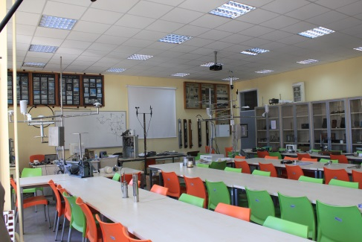
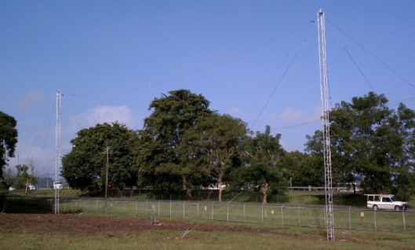
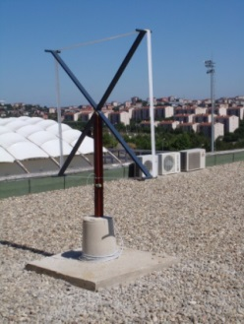
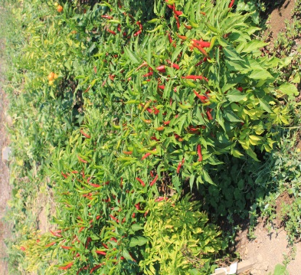
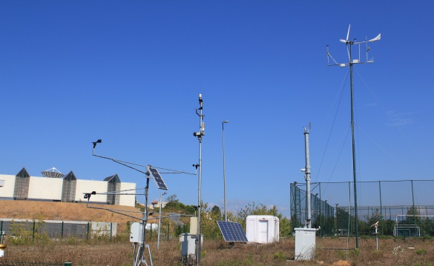
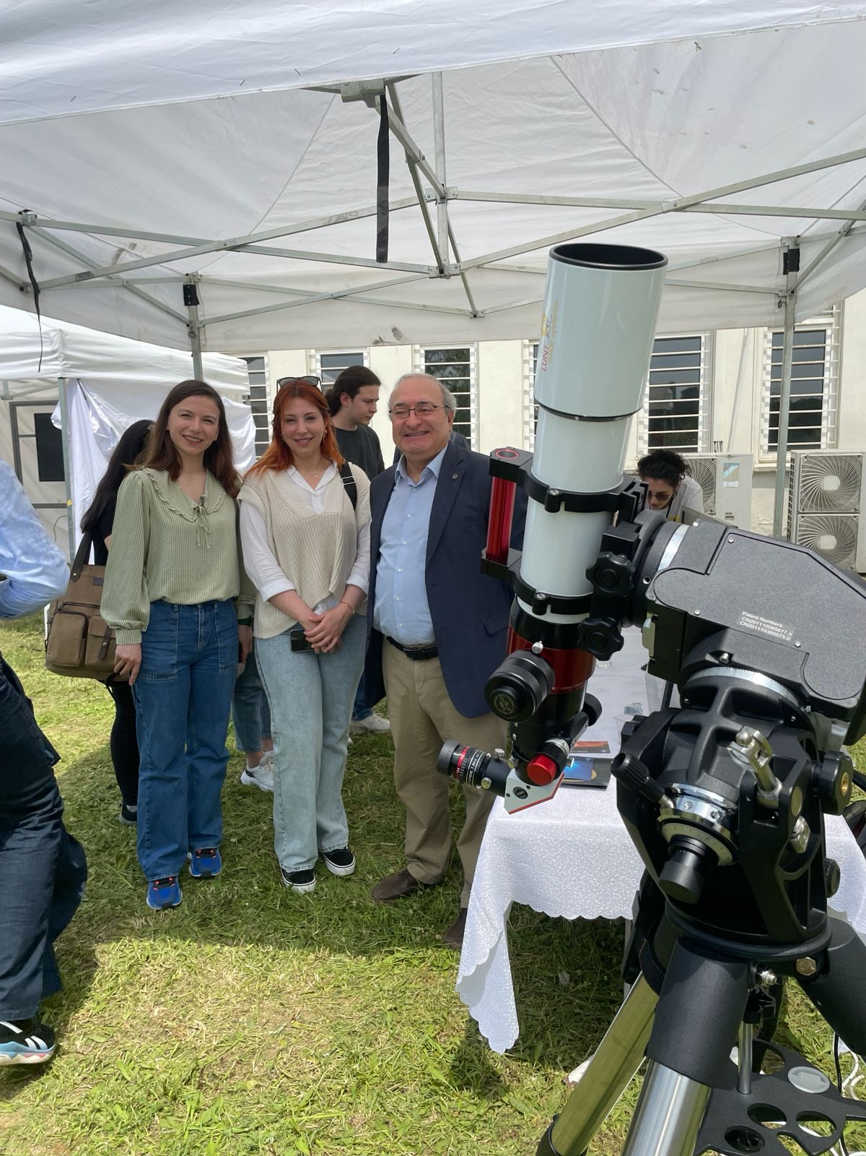
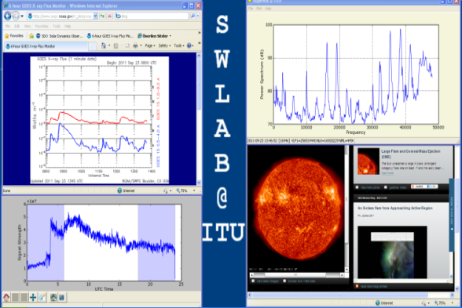
WHAT ARE THE R&D/DESIGN OPPORTUNITIES?
Practical applications, design projects, and experimental studies are conducted in various facilities actively used in related courses, including:
Open-air meteorological observation park,
Meteorological instruments and observation methods laboratory,
Atmospheric modeling and analysis laboratory,
Upper atmospheric physics laboratory,
Weather analysis and briefing laboratory,
Energy and climate systems laboratory.
SID anteni
SID anteni
6/18

Slide 16
CLIMATE SCIENCE AND METEOROLOGICAL ENGINEERING: DEPARTMENT LABORATORIES
Lab Name
Meteorological Instruments and Observation Methods Laboratory
Atmospheric Modeling and Analysis Laboratory
Upper Atmosphere and Space Weather Laboratory
Lab Name
Meteorology Eng. Briefing Room
Meteorological Observation Park
Sustainable Energy and Climate Systems Laboratory

Slide 17
CLIMATE SCIENCE AND METEOROLOGICAL ENGINEERING: DEPARTMENT LABORATORIES
Meteorological Observation Park
This area features instruments that directly measure the sky, wind, temperature, and other weather phenomena. Students can observe on-site how weather is measured and how forecasts are made.
Meteorological Instruments and Observation Methods Laboratory
In this laboratory, various weather measurement instruments are introduced and their usage is demonstrated. Students can gain hands-on experience learning how rainfall is measured or how wind direction is determined.
Atmospheric Modeling and Analysis Laboratory
Computers are used here to understand how the atmosphere moves. Students learn how future weather conditions are predicted and the role of computer models in this process.
Upper Atmosphere and Space Weather Laboratory
This area focuses on studying the layers of the atmosphere high above the ground. Data is collected using balloons to investigate how sunlight and winds behave at those altitudes.
Weather Analysis and Briefing Laboratory
This lab is where pre-flight weather briefings for pilots are prepared. Students explore how weather is analyzed to ensure safe flight conditions and how this information is presented.
Sustainable Energy and Climate Systems Laboratory
In this lab, the relationship between natural energy sources like solar and wind power and the climate is examined. Students learn how clean energy sources affect the environment and their connection to climate change.

Slide 18
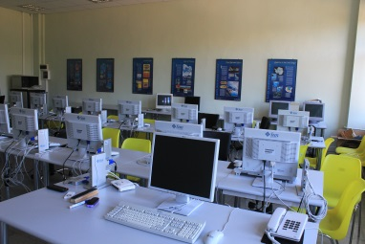
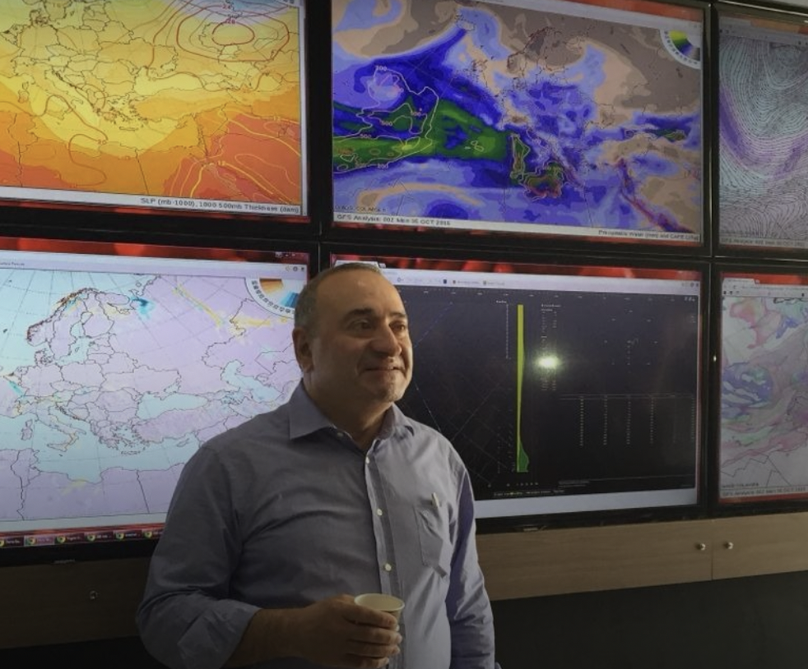
CLIMATE SCIENCE AND METEOROLOGICAL ENGINEERING: DEPARTMENT LABORATORIES
Meteorology Modeling and Analysis Laboratory
Synoptic Meteorology Laboratory and Briefing Room
Upper Atmosphere and Space Weather Laboratory

Slide 19
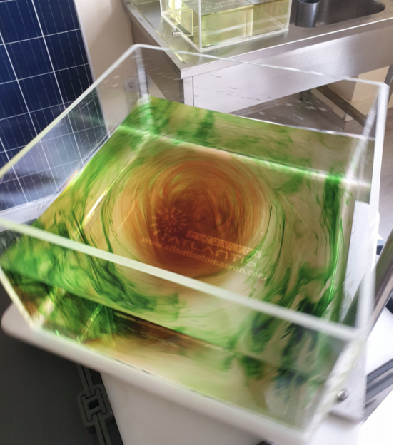
CLIMATE SCIENCE AND METEOROLOGICAL ENGINEERING: DEPARTMENT LABORATORIES
Meteorology Observation Park
Meteorological Instruments and Observation Methods Laboratory
Sustainable Energy and Climate Systems Laboratory

Slide 20
SOFTWARE USED IN OUR FACULTY COMPUTER LABORATORY
ANSYS 15.0
Fortran Ranersitation 4,0
Nx Nastran 9.0
AutoCAD 2014
Linux
Microsoft Fevelop
Solidworks
Fluent 15.0
Visual Studio 2013
WinRAR
Windows Kits
SSH Secure Shell
NETCAD GIS
SolidWorks 2014

Slide 21

ACADEMIC EXCELLENCE
Program Highlights:
  Accredited by international engineering organizations (e.g., ABET).
  Curriculum combining atmospheric science, environmental systems, and engineering techniques.
Advanced Facilities:
  State-of-the-art weather labs, modeling tools, and observational equipment.
  Collaboration with national and international meteorological organizations.
Expert Faculty:
  Experienced professors with global research impact.
  Active industry involvement and applied research projects.

Slide 22

SCIENTIFIC RESEARCH TOPICS
The scientific research topics of the faculty members in the Department of Climate Science and Meteorological Engineering cover a wide range of areas based on their doctoral training:
- Agricultural and forestry meteorology
- Atmospheric analysis, forecasting, and modeling
- Atmospheric radiation and atmospheric boundary layer
- Solar-climate system interaction
- Climate change and climate modeling
- Atmosphere-ocean interaction
- Solar and wind energy
- Micrometeorology - mesometeorology
- Cloud and precipitation physics
- Air pollution and modeling
- Stratospheric ozone
- Chaos and nonlinear dynamics applications
- Hydrology - hydrometeorology
- Water resources, their development, and management
- Flood - storm - avalanche - drought analysis
- Architectural meteorology - urban meteorology
- Biometeorology - medical meteorology
- Aviation - marine - satellite meteorology
- Military meteorology
- Upper atmosphere - ionosphere - magnetosphere physics

Slide 23







INDUSTRY PARTNERSHIPS OF ITU CLIMATE SCIENCE AND METEOROLOGICAL ENGINEERING
The Department of Climate Science and Meteorological Engineering at Istanbul Technical University (ITU) collaborates with a range of domestic and international companies in various research and projects. These companies typically provide support in areas such as weather forecasting, climate change, meteorological modeling, remote sensing, and data analysis. Some examples are as follows:
1. Turkish Airlines : The ITU Climate Science and Meteorological Engineering Department collaborates with Turkish Airlines, particularly in the fields of airport meteorology and flight safety. This partnership involves the sharing of information related to air traffic management and the adjustment of flights based on weather conditions.
2. TÜBİTAK : ITU works with TÜBİTAK on various research projects. Projects funded by TÜBİTAK related to meteorology and climate change are supported by ITU’s scientific contributions.
3. Turkish State Meteorological Service (TSMS) : ITU collaborates with TSMS on data sharing and modeling. This collaboration focuses on enhancing the accuracy of weather forecasts.
4. Havelsan : Havelsan, a company operating in the defense and aviation sectors, collaborates with ITU on meteorological modeling and weather forecasting systems.
5. Turk Telekom and other technology companies : ITU collaborates with technology companies, especially in the digitalization of meteorological data and the development of remote sensing technologies.
These collaborations are crucial for improving the accuracy of meteorological data analysis and developing innovative solutions.
9/18

Slide 24


INTERNATIONAL RECOGNITION OF ITU CLIMATE SCIENCE AND METEOROLOGICAL ENGINEERING PROGRAM
As the only Meteorological Engineering Department in the world fully accredited by ABET, our students gain the skills needed to pursue their profession internationally and can continue their careers around the globe.
9/18

Slide 25





STUDENT TEAMS
Meteorological Research Club (METAR)
METEO Coding Team
METEO Remote Sensing Team
METEO Modeling Team
METEO Forecast Team
Balloon Team
Reporting Team
ITU Aqua Team
SUSTECS
15/18

Slide 26


STUDENT CLUBS
What is METAR?
ITU Meteorological Research Club (METAR) is a dynamic and scientific research club formed by Istanbul Technical University students. The aim of the club is to increase social awareness of meteorology and to ensure the sectoral development of students.

Slide 27



STUDENT CLUBS
What Does METAR Do?
Training and Seminars: Trainings are organized with experts in the field. Technical trips are planned and on-site observation of the sector is ensured.
Social Activities: Meetings and member gatherings are held to keep the unity among students alive.
Scientific Studies: Research is conducted and projects are developed in the fields of meteorological reporting, coding and modelling within the project teams established under the club roof.

Slide 28



Thank You
itumeteo
İTÜ İklim Bilimi ve Meteoroloji Mühendisliği
Notes:
Fakülte web sayfası, dijital platformları sol altta bulunacak.

